Slide 1
Disclosure: Protecting Your Brand and Your Butt
By Ashley Coombe
@ashleybcoombe

Slide 2


Slide 3


Slide 4


Slide 5


Slide 6
Disclosing the financial relationship
Clear and conspicuous
Not at footer or separate disclosure page
Next to active affiliate links
Clear across all devices

Slide 7
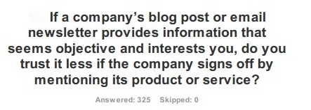
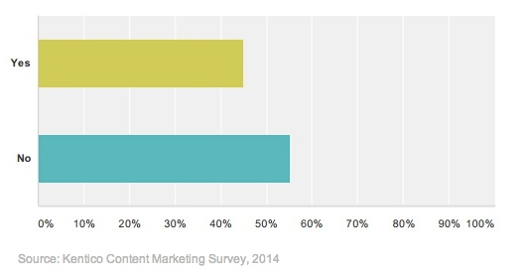

Slide 8
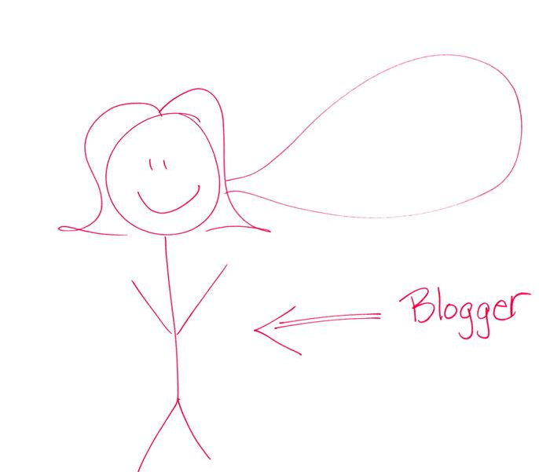
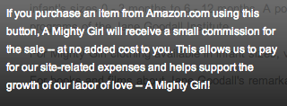
Notes:
You’ve built the relationship. Use that to explain why you’re doing what you’re doing.

Slide 9
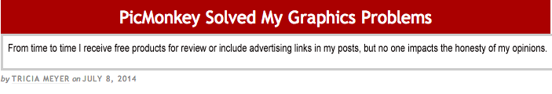

Slide 10
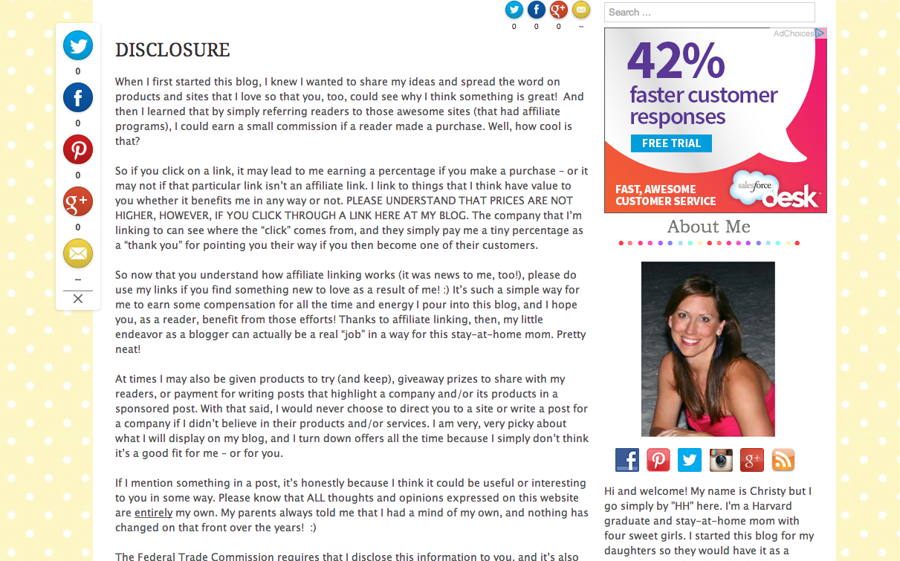

Slide 11


Slide 12


