Slide 1


Crafting the
Perfect Review
Prepared by
Carolyn Tang Kmet
CMO, All Inclusive Marketing

Slide 2

01
Why Product Reviews?
AGENDA
02
Creative Elements
03
Technical Elements
04
Q & A

Slide 3
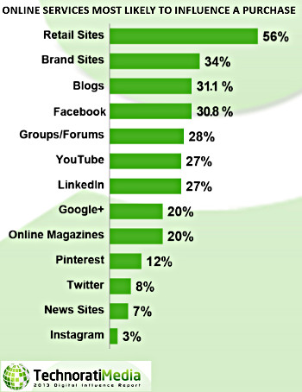
01
Why Product Reviews?
Buyers Seek Pre-Purchase Information
31.1% of purchase decisions are influenced via blogs
Unbiased, credible information
Engagement with like-minded consumers
Trendsetters, influencers
64% of influencers generate revenue via blogging
11% say they make more than $30,000 per year
Source: http://technorati.com/wp-content/uploads/2013/06/tm2013DIR1.pdf

Slide 4
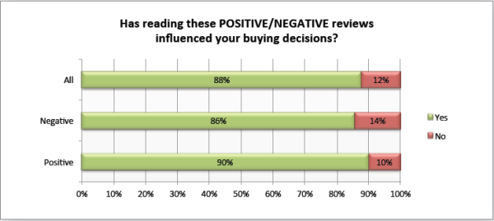
01
Why Product Reviews?
Product Reviews Influence Purchase Decisions
Dimensional Research Survey in 2013, base of 1,047 buyers:
90% said positive online reviews influenced their buying decision
86% said negative online reviews influenced their buying decision
Source: http://marketingland.com/survey-customers-more-frustrated-by-how-long-it-takes-to-resolve-a-customer-service-issue-than-the-resolution-38756

Slide 5

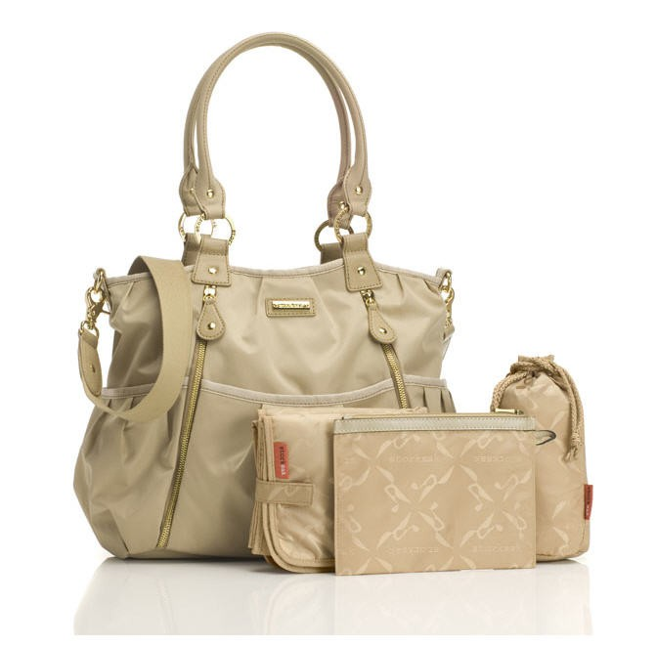
02
Creative Elements
What Goes into a Product Review
No need to regurgitate what’s on the retail or brand site:
Product specifications: dimensions, price, etc.
Product feature comparisons
Where to buy
Product images
Booooring....

Slide 6
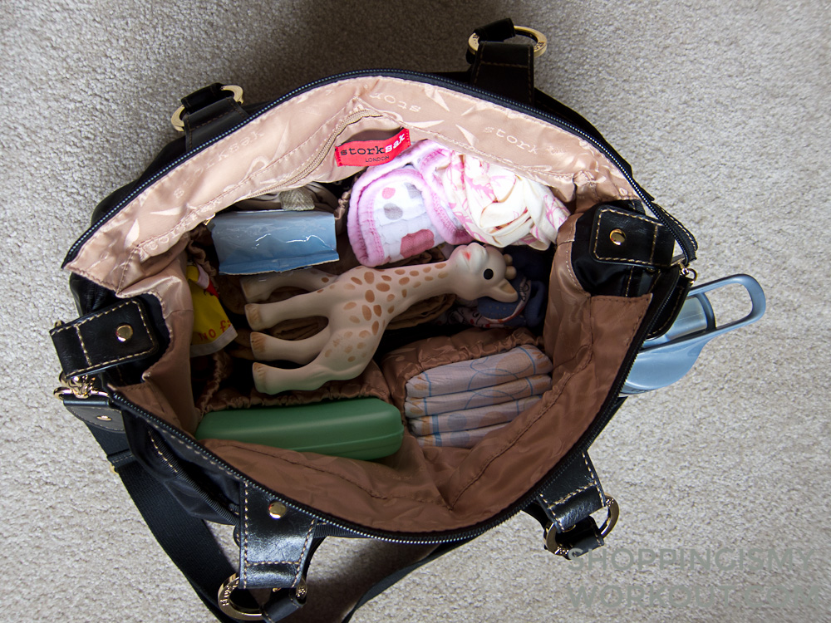
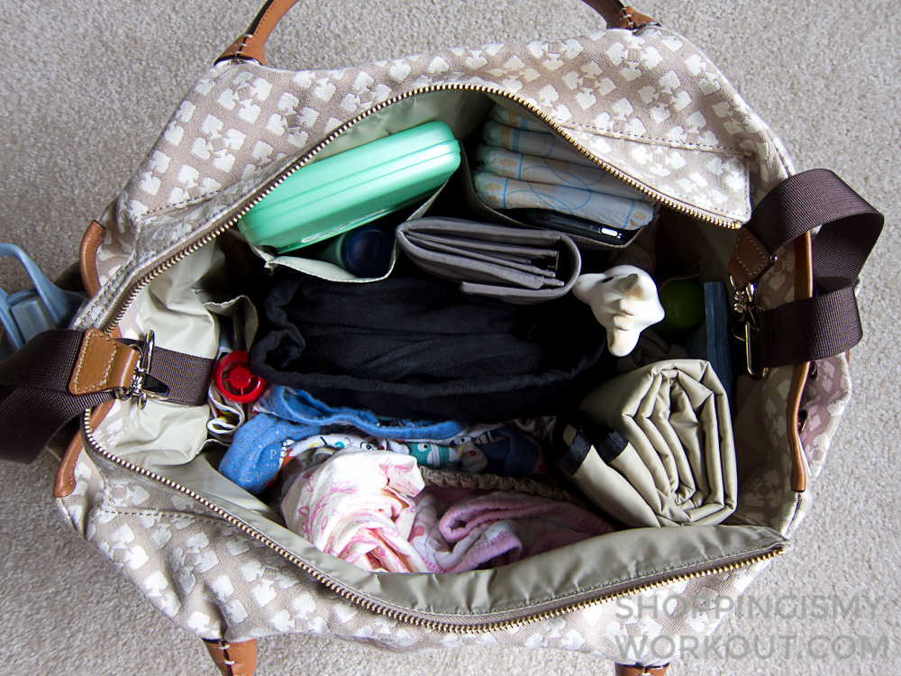
01
Creative Elements
02
What Goes into a Product Review
Show how the product holds up in real life.
Functionality: What’s in my bag, tutorials
Sensory Elements: smell, feel, swatches
Modeling Shots: Height, build, front, back, side
Product Details: Hardware, wear and tear
Pros and Cons: Like the product, hate the packaging
Product Hacks: LV cross-body chain
Source: http://www.shoppingismyworkout.com/diaper-bag-comparison-review-kate-spade-stevie-vs-storksak-olivia/

Slide 7
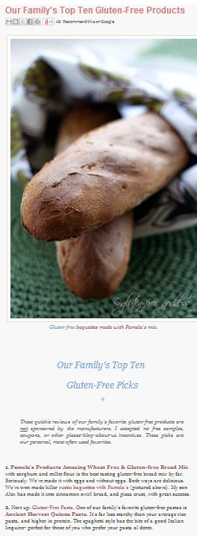
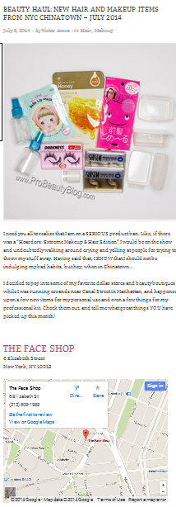
01
Creative Elements
02
What Goes into a Product Review
Different ways to present a product review
Focus on single product
Focus on multiple products: monthly favorites, shopping hauls, tutorials
Shared experience: Unboxings
Sneak peeks: Julep Maven boxes
Video, video, video
Source: http://glutenfreegoddess.blogspot.com/2005/12/top-ten-gluten-free-products-2005.html, http://probeautyblog.com/beauty-haul-new-hair-and-makeup-items-from-nyc-chinatown-july-2014/

Slide 8
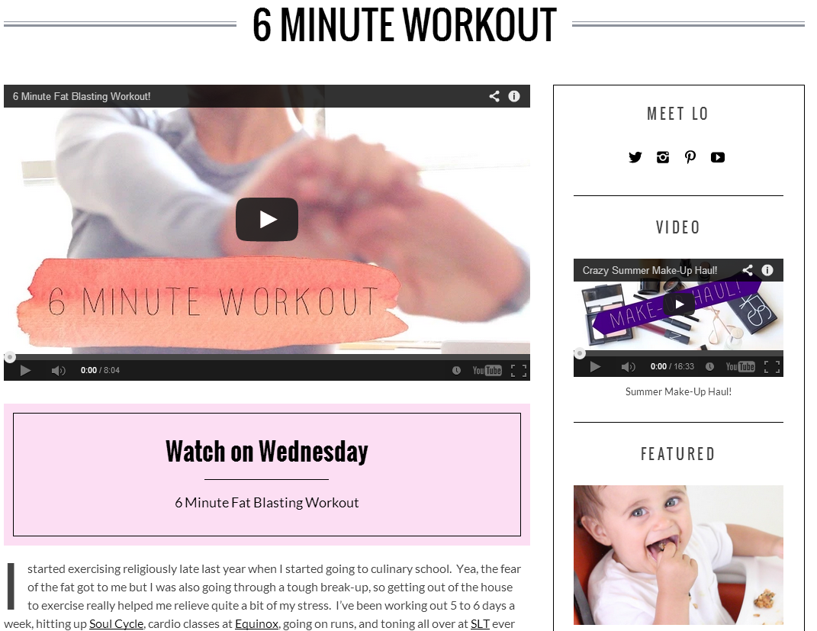
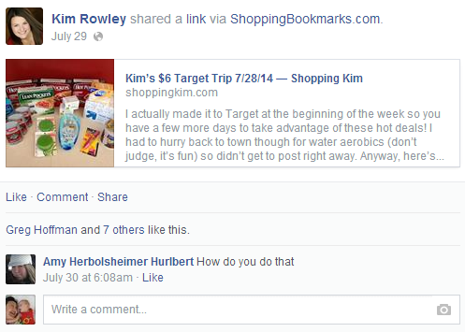
03
Technical Elements
How to Monetize Product Reviews
Distribute review across multiple channels, but entice consumers to your site for deeper content
  Tutorial on YouTube, links to products used on blog
  Teaser photo on Facebook, Twitter, Pinterest, Instagram; link to full photo spread on blog
Source: http://thelodown.com/fashion/6-minute-workout, http://shoppingkim.com/kims-6-target-trip-72814/

Slide 9
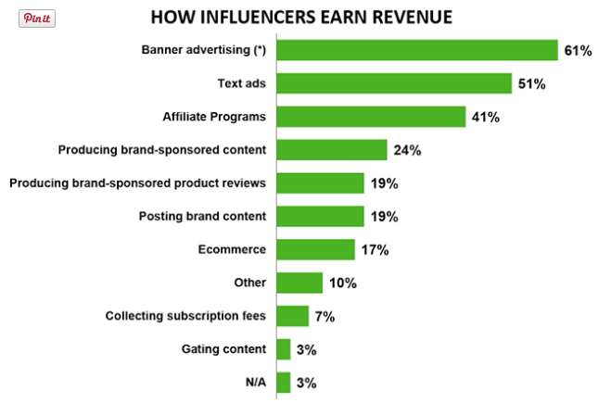
03
Technical Elements
How to Monetize Product Reviews
Source: http://technorati.com/report/2013-dir/influencers-revenue/

Slide 10
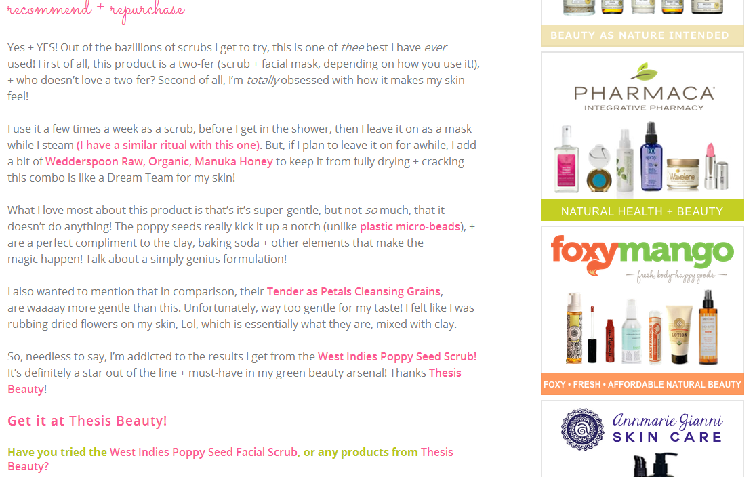
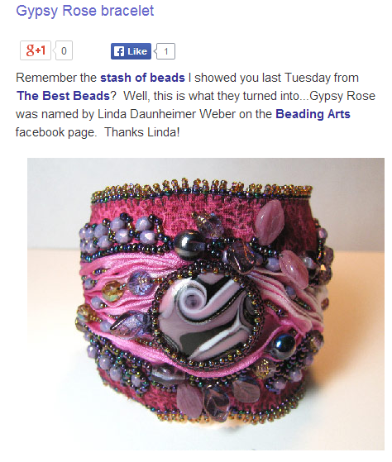
03
Technical Elements
How to Monetize Product Reviews
Paid placements: quick fix, single payout
Affiliate links: longevity, lifetime payout, entry-level brand relationship
User-generated content: VigLinks, SkimLinks
Source: http://www.glamorganicgoddess.com; http://www.beading-arts.com

Slide 11
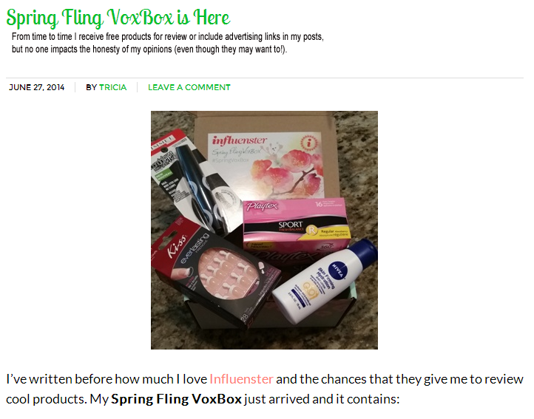
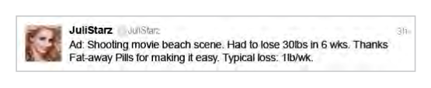
03
Technical Elements
How to Monetize Product Reviews
Don’t forget your FTC disclosure!
Blogs: Include clearly worded language at the beginning of each post that clearly describes your affiliation or compensation with the products or retailers contained in the post
Tweets, Pins, Status Updates: Preface with “Ad”, or include hashtags that clearly identify the item as an ad, example: #sponsored
Source: http://www.helpingmomsconnect.com; http://www.ftc.gov/sites/default/files/attachments/press-releases/ftc-staff-revises-online-advertising-disclosure-guidelines/130312dotcomdisclosures.pdf

Slide 12
04
Q & A
Questions, Comments,
Kindly Worded
Complaints?
Carolyn Kmet
CMO, All Inclusive Marketing
carolyn@allinclusivemarketing.com
Skype: Carolyn.Kmet

