Slide 1


PRODUCT REVIEWS
(That People Want to Share)
RAE HOFFMAN
ASE 2014

Slide 2
RAE HOFFMAN
@Sugarrae
http://sugarrae.com
http://pushfire.com

Slide 3
TIRED REVIEWS
400 words
Manufacturer product pictures / screenshots
Generic product / Service overview
Feature based
Reads like an ad
Just… NO

Slide 4
WIIFM

Slide 5
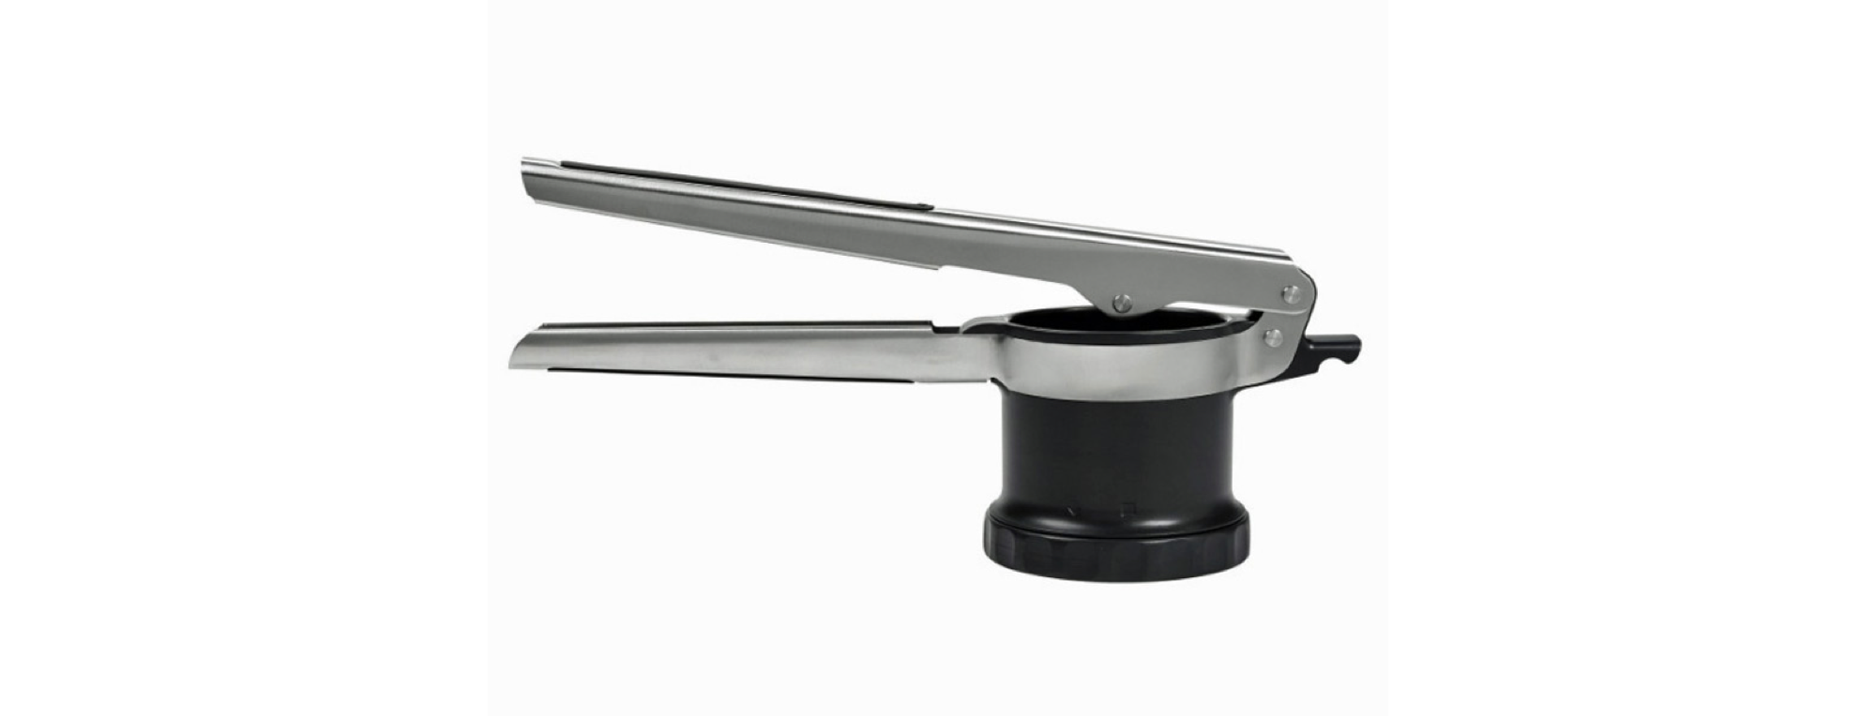
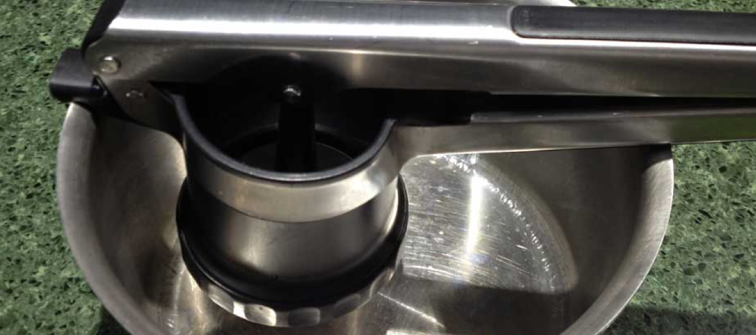

Slide 6
FEATURES
BENEFITS

Slide 7
HOW TO USE IT
(Features)

Slide 8
NEVER
EVER
sell out the TRUST
of your readers
to make a commission

Slide 9

NO PRODUCT IS PERFECT
(and people don’t expect it to be)

Slide 10
HOW YOU CAN USE IT
(Benefits)

Slide 11
SOLVE
PROBLEMS

Slide 12



Slide 13
KILLER REVIEWS
As long as it needs to be
Real pictures / screenshots
Features AND Benefits
Pros AND Cons
Reads like a “how to”
Offers more tutorials
Just… NO

Slide 14


Slide 15
THANK YOU
Awesome advice for bloggers
http://sugarrae.com
Consulting for merchants &
businesses
http://pushfire.com
Kicks in the ass
http://facebook.com/therealsugarrae
Ranting & cursing & football
https://twitter.com/sugarrae

